Slide 1
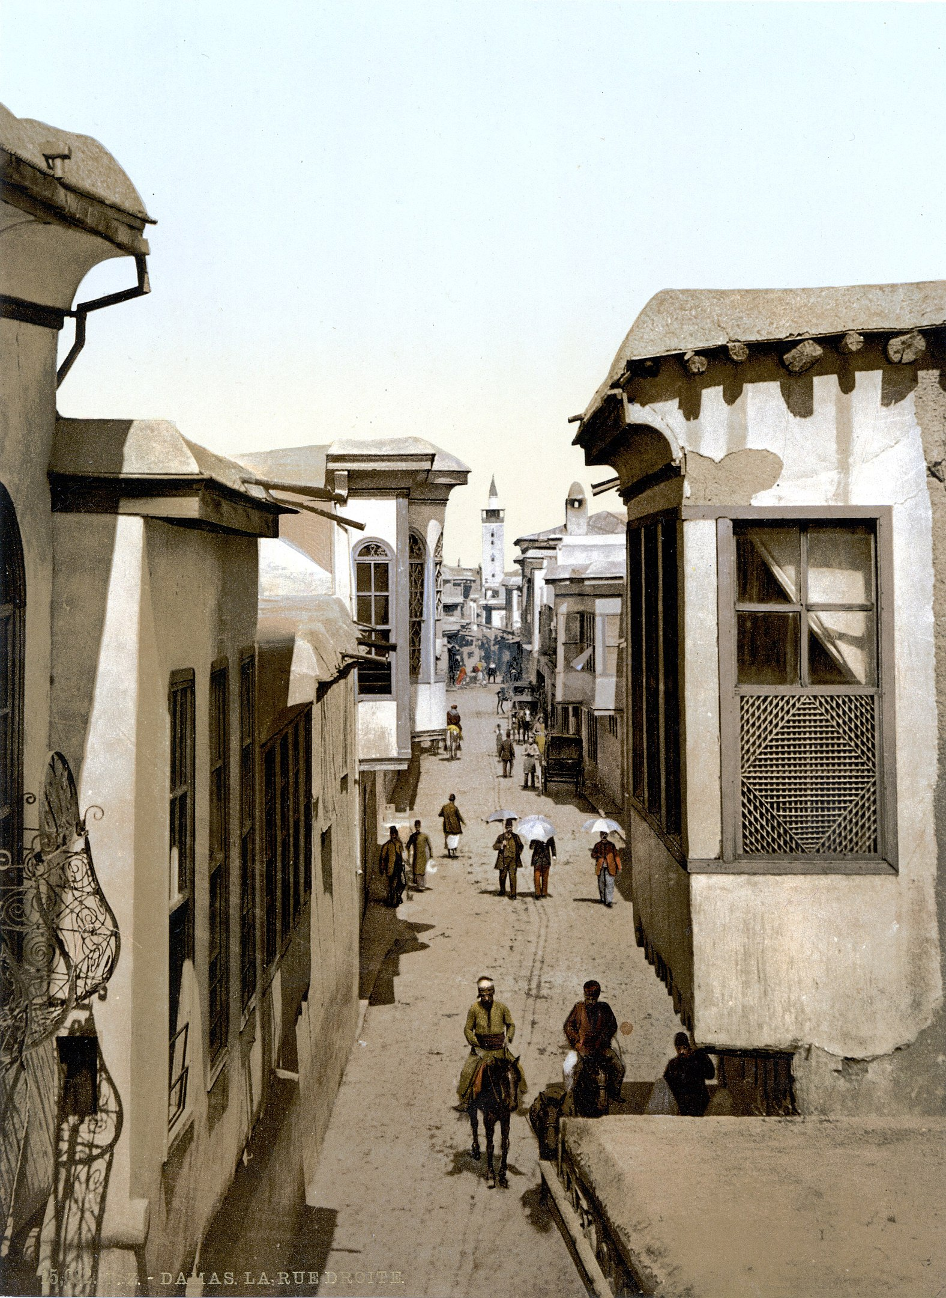
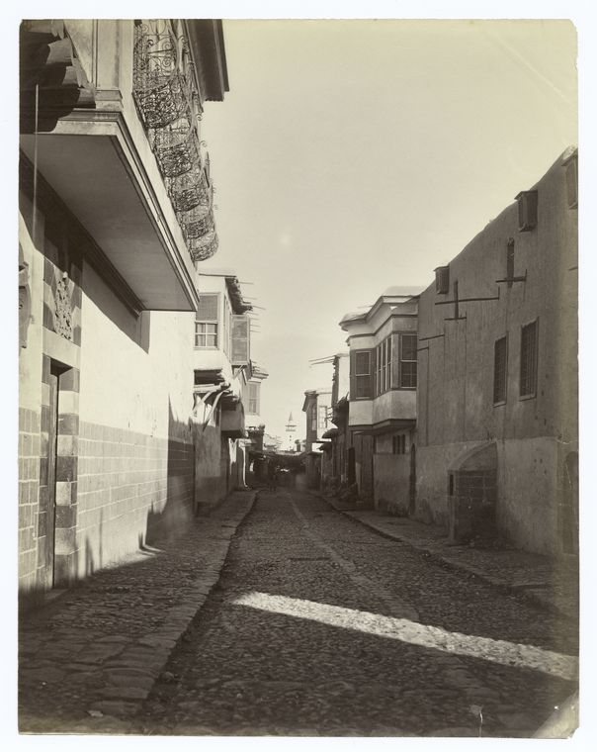
Straight Street, Damascus, c.1900.

Slide 2
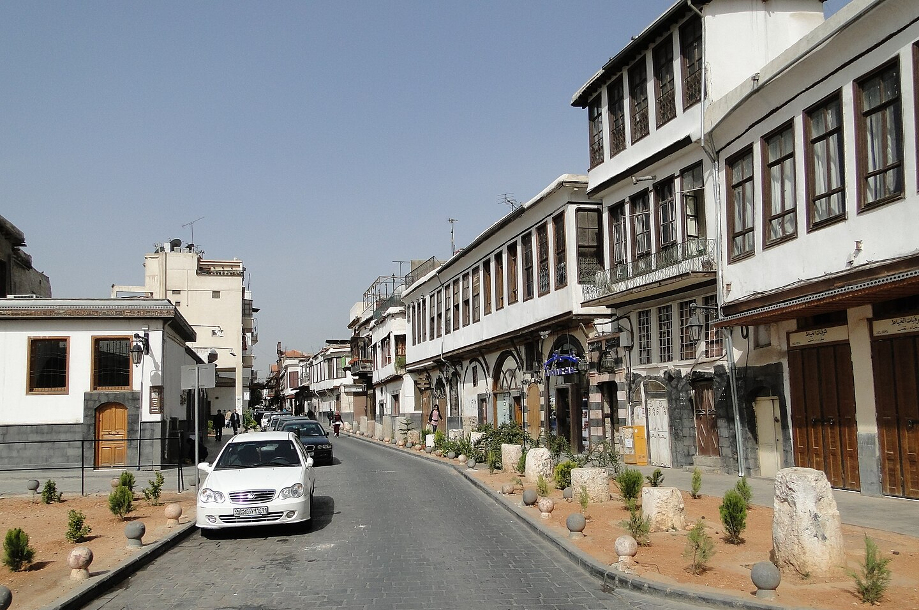
Straight Street, Damascus, 2010
By Bernard Gagnon - Own work, CC BY-SA 3.0, https://commons.wikimedia.org/w/index.php?curid=10421754

